Slide 1
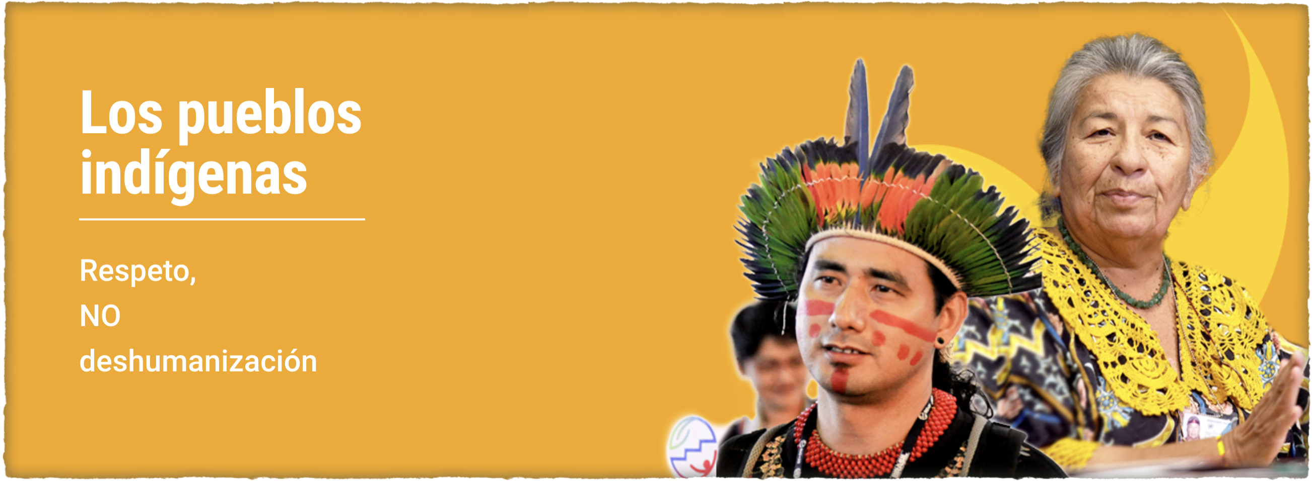

Protection of Regional Human Rights Systems
Dr. Sandra Ceballos
IPARD Program
FSC INDIGENOUS FOUNDATION

Slide 2

Inter-American Human Rights System
-
- The inter-American human rights system formally began with the adoption of the American Declaration of the 9th International Conference of American States held in Bogotá in 1948, in the framework of which the OAS Charter itself was also adopted, proclaiming the "fundamental rights of the human person" as one of the founding principles of the Organization.

Slide 3
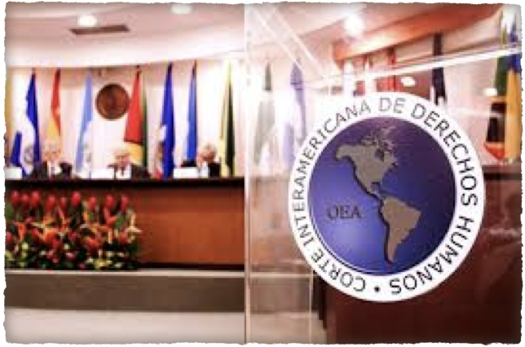
Commission and the Inter-American Court of Human Rights
-
- American Convention
- The Commission and the Court are the competent bodies to hear matters related to compliance with the commitments undertaken by the States Parties to the Convention and regulate their functioning.

Slide 4
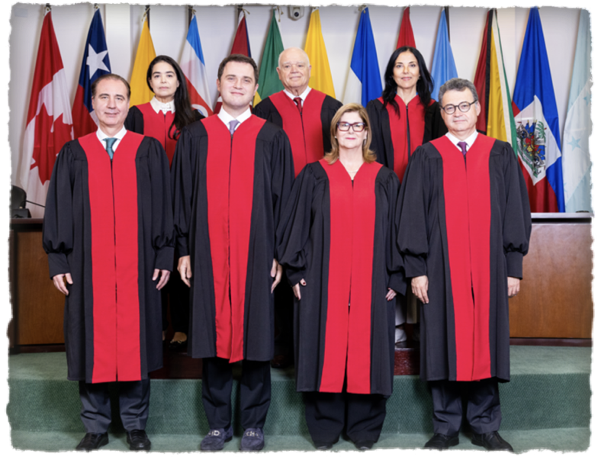
Inter-American Court of Human Rights
- One of the three regional courts for the protection of human rights,
-Autonomous judicial institution whose purpose is to apply and interpret the American Convention.
- It exercises a contentious function, which includes the resolution of contentious cases and the mechanism for supervising sentences; an advisory function; and the function of issuing provisional measures.

Slide 5

https://www.corteidh.or.cr/que_es_la_corte.cfm

Slide 6
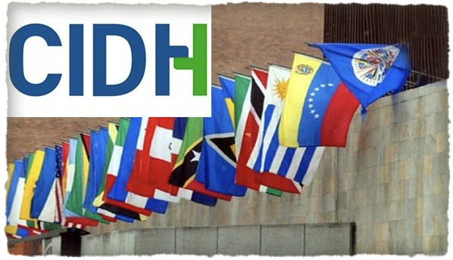
Inter-American Commission on Human Rights
https://www.oas.org/es/cidh/
- Main and autonomous body of the OAS responsible for the promotion and protection of human rights in the Americas.
- Composed of 7 independent members who serve in a personal capacity.
- Headquarters in Washington, D.C.
- Created by the OAS in 1959 and, jointly with the Inter-American Court of Human Rights (IACHR), installed in 1979, it is an institution of the Inter-American System for the protection of human rights (ISHR).

Slide 7
The IACHR carries out its work based on three pillars:
the Individual Petition System
monitoring the human rights situation in Member States, and
attention to priority thematic lines.
- considers it essential to pay attention to populations, communities and groups historically subjected to discrimination.
- the pro personae principle
- the need for access to justice,
- the incorporation of the gender perspective in all its activities.

Slide 8

African human rights system
The African Charter on Human and Peoples' Rights (ACHPR)
The African Commission on Human and Peoples' Rights
The body responsible for supervising and monitoring compliance with human rights in the 53 member states of the African Union.
The African Court on Human and Peoples' Rights
The first jurisdictional organ of the system that can issue sentences and condemn States for human rights violations.

Slide 9
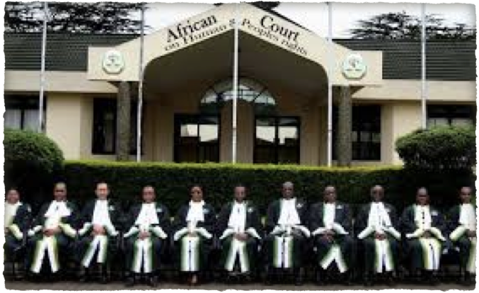
African Court on Human and Peoples' Rights
Judiciary of the African Union.
It was created with a view to ensuring the protection of human and peoples' rights in Africa, mainly through its judgments.
Permanent headquarters in Arusha, United Republic of Tanzania.

Slide 10

Injunction
Complement and strengthen the functions of the African Commission on Human and Peoples' Rights (the African Commission, commonly known as the Banjul Commission), which is a quasi-judicial body responsible for monitoring the implementation of the Charter.

Slide 11

VISION
Africa with a viable human rights culture.
FUNDAMENTAL VALUES
are based on the African Charter and other internationally recognized human rights principles and the promotion of the rule of law.

Slide 12
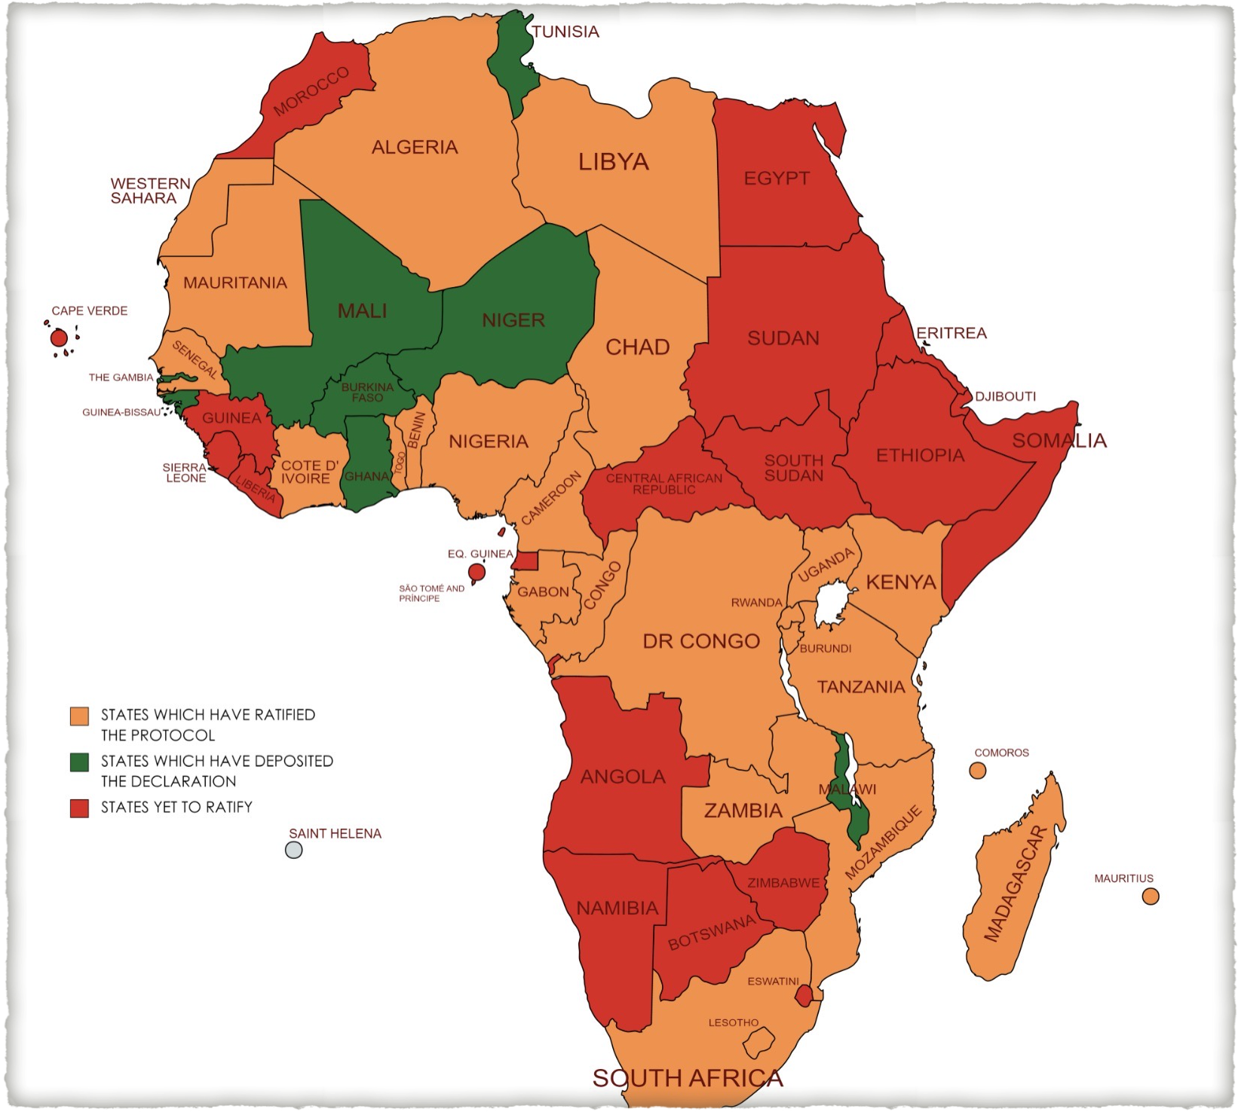
54 of the 55 member states of the African Union (AU) have ratified or acceded to the African Charter on Human and Peoples' Rights, with the exception of Morocco, and have therefore committed themselves to respect the principles enshrined in the Charter.
Currently, only 31 member states have ratified the Protocol establishing the African Court.
Only six (6) States have accepted the jurisdiction of the Court, in terms of Article 34(6), according to which individuals and NGOs may submit petitions directly to the African Court.
In the absence of such a declaration, the petition must first be submitted to the Banjul Commission, which in turn may - after a preliminary analysis - decide to refer the case to the Court.

Slide 13
Strategic Objectives
The Court's Strategic Objectives are part of its mandate and include the following terms of reference:
To exercise jurisdiction over all cases and disputes brought before the Court relating to the interpretation and application of the Charter, the Protocol and any other human rights instruments ratified by the States concerned;
Collaborate with subregional and national judicial bodies with a view to strengthening the protection of human rights in the hemisphere;
Improve the participation of African populations in the Court's activities;
Strengthen the capacities of the Registry of the Court to enable it to fulfill its mandate; and
Deepen the working relationship between the Court and the African Commission.

