Slide 1
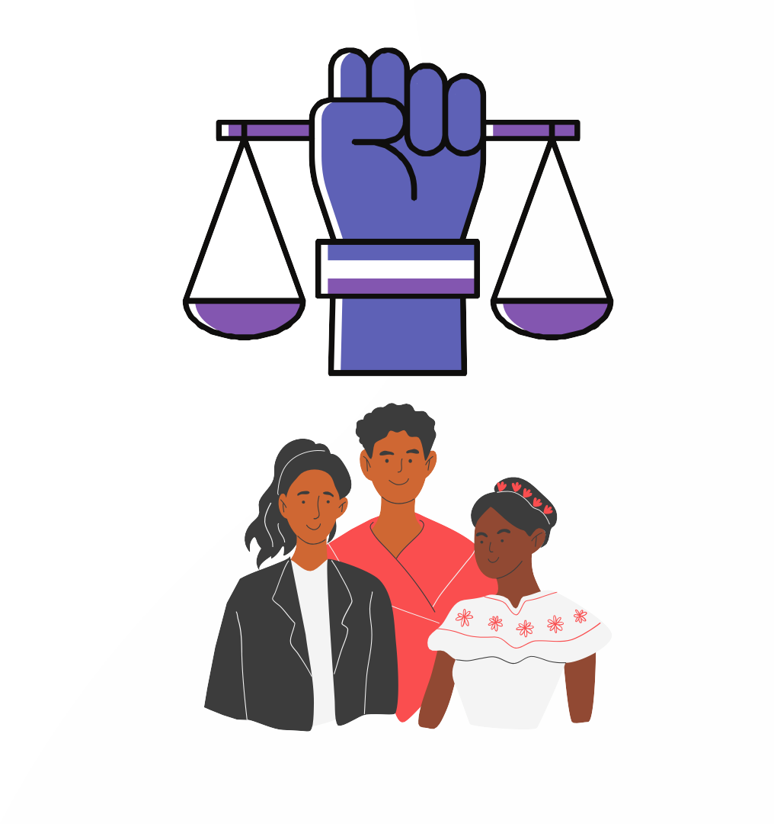
HUMAN RIGHTS AND INDIGENOUS PEOPLES' RIGHTS
This material was made possible through support provided by the Office of Inclusive Development Hub, Bureau for Inclusive Growth, Partnerships, and Innovation, U.S. Agency for International Development, under the terms of Contract No.7200AA20CA00013. The opinions expressed herein are those of the authors and do not necessarily reflect the views of the U.S. Agency for International Development.

Slide 2
HUMAN RIGHTS
1.1 CONCEPT: "Human rights are rights inherent to all human beings, without distinction of any kind, such as race, sex, nationality, ethnic origin, language, religion or any other status."( United Nations 2015).
1.2 FUNDAMENTAL ELEMENTS OF HUMAN RIGHTS:
Universality: Human rights are universal and apply to all persons without distinction of any kind.
Inalienability: Human rights cannot be assigned, transferred or renounced; they are inherent to each person.
Indivisibility: Human rights are indivisible and interdependent, which means that the violation of one right may affect the enjoyment of others.
Equality and non-discrimination: All individuals should enjoy human rights without discrimination of any kind.
Participation and inclusion: All people have the right to participate in making decisions that affect their lives and to access mechanisms to protect their rights.

Slide 3
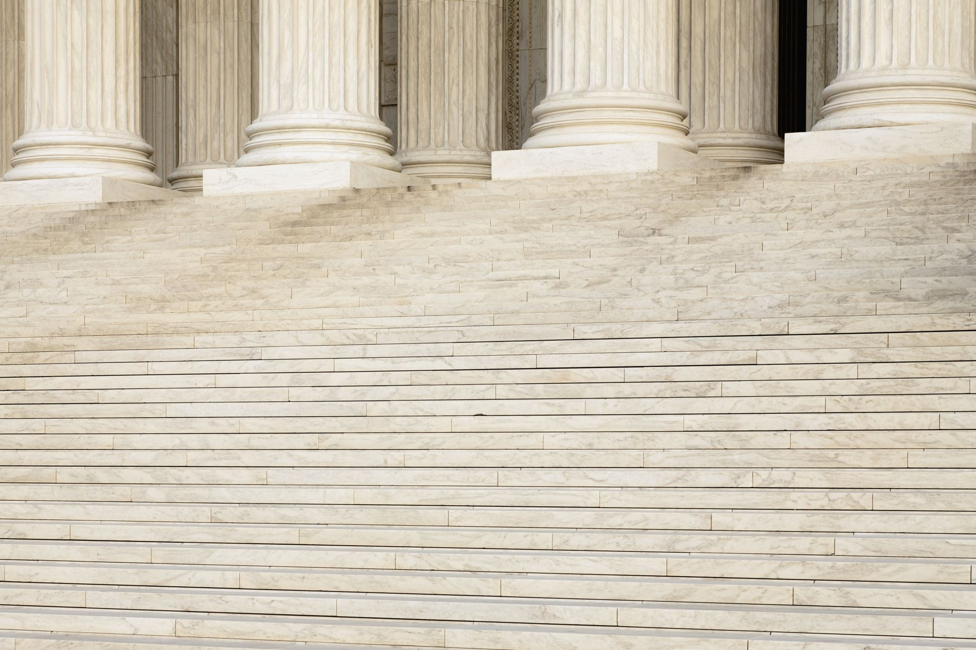
1.3 SCOPE OF APPLICATION OF HUMAN RIGHTS
Elements of Application of the Inter-American System
Protection and Promotion of Rights: The IACHR monitors and promotes the protection of human rights in the Americas, ensuring that member states comply with their international obligations.
Access to Justice: The Inter-American Court of Human Rights provides a forum for the resolution of cases and judicial protection of human rights, allowing victims of violations to access justice and reparations.
Observation and Monitoring: The IACHR conducts visits, investigates and publishes reports on the human rights situation in member countries, promoting transparency and accountability.
Precautionary and Provisional Measures: The Court and the IACHR may take precautionary measures to protect the rights of persons in urgent situations or situations of imminent risk.
Recommendations and Judgments: The IACHR issues recommendations for the implementation of corrective measures and the Court issues binding judgments for States in cases of human rights violations.
Training and Advisory Services: The system provides training and advisory services to member states to strengthen their capacity to protect and promote human rights.

Slide 4
HOW ARE THE RIGHTS OF INDIGENOUS PEOPLES BORN?
1
1948 - THE UNIVERSAL DECLARATION OF HUMAN RIGHTS (UDHR), ADOPTED BY THE UNITED NATIONS GENERAL ASSEMBLY.
2
1977 - BEGINNING OF DISCUSSIONS ON THE RIGHTS OF INDIGENOUS PEOPLES (UN) 1970
3
1993 - CREATION OF THE WORKING GROUP ON INDIGENOUS PEOPLES
4
2007 - UNITED NATIONS DECLARATION ON THE RIGHTS OF INDIGENOUS PEOPLES

Slide 5
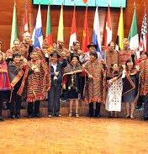
2. RIGHTS OF PEOPLES AND NATIONALITIES
2.1 TERRITORY: "Territory is understood not only as the physical space occupied by a community, but also as the space where its cultural, social and economic activities are carried out, and where its identity and autonomy are exercised. The right to territory includes the right to ownership, use, access and control of natural resources, as well as respect for and protection of ancestral lands and traditional ways of life."
DIFFERENCE BETWEEN LAND AND TERRITORY
LAND: Refers to a specific surface area that may be owned or used by a person or group. In legal terms, it is a specific portion of the land.
TERRITORY: Includes not only land, but also natural resources, cultural and spiritual space, and the social and economic relationships that Indigenous Peoples have with their environment. It is a broader concept that encompasses the cultural, historical and social use and meaning of space.

Slide 6
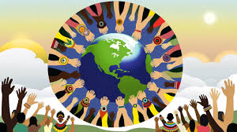
2.2 ORGANIZATION:
The OHCHR (Office of the United Nations High Commissioner for Human Rights) emphasizes that Indigenous Peoples have the right to maintain and strengthen their own political, legal, economic, social and cultural institutions. This right includes full and effective participation in decisions that affect them and control over their economic and social development. OHCHR supports national legislative changes, provides legal analysis and encourages cooperation with state authorities to promote these rights (OHCHR) (OHCHR).

Slide 7
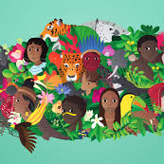
2.3 CULTURE: Culture comprises the beliefs, customs, arts, history, languages, knowledge and practices that characterize a social group or society as a whole. In the context of human rights, the right to culture includes the protection of cultural manifestations, the promotion of cultural diversity and respect for the traditions and ways of life of Indigenous communities and minorities." ( UNESCO)
2.4 SELF-DETERMINATION: The concept of self-determination for Indigenous Peoples, according to the Inter-American Commission on Human Rights (IACHR), implies the capacity of these peoples to define their own development and self-government structures within the framework of the States in which they reside. Self-determination is understood not only in terms of political independence, but also as the right to maintain and develop their own political, economic, social and cultural institutions. This right is linked to other fundamental rights such as integrity, cultural identity, non-discrimination, and collective ownership of their lands and natural resources (IWGIA).

Slide 8
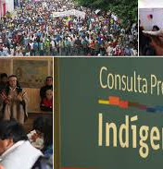
2.5 CONSULTATION AND PARTICIPATION: Consultation and participation of Indigenous Peoples refers to their right to be consulted and to participate in decisions affecting their rights, territories and resources. This right implies that States must obtain the free, prior and informed consent of Indigenous Peoples before taking measures that may impact them. The effective participation of Indigenous Peoples is essential to ensure that their voices and needs are considered in decision-making processes.
The United Nations Declaration on the Rights of Indigenous Peoples states:
Article 18: "Indigenous Peoples have the right to participate in decision-making at the appropriate levels on matters affecting them, and to have access to resources that enable them to participate effectively".
Article 19 "States shall consult Indigenous Peoples through appropriate procedures and in good faith, in order to obtain their free, prior and informed consent before adopting legislative or administrative measures that may affect them."

Slide 9
CONSULTATION
Definition: Process by which States must obtain the free, prior and informed consent of Indigenous Peoples before taking decisions or measures that may affect them, especially in relation to their rights, territories and resources.
Legal Basis: ILO Convention 169: Article 6UN Declaration on the Rights of Indigenous Peoples: Article 19Objective: To ensure that indigenous Peoples are informed and that their views and concerns are considered before measures affecting them are implemented.
PARTICIPATION
Definition: The right of Indigenous Peoples to be actively involved in decision-making and policy development that affects them, at appropriate levels.
Legal basis:
  United Nations Declaration on the Rights of Indigenous Peoples: Articles 18 and 27
Objective: To ensure that Indigenous Peoples can influence the formulation of policies and decisions that impact their political, economic, social and cultural life.

Slide 10
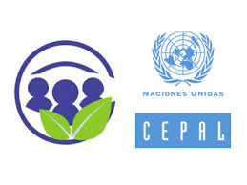
3. INTERNATIONAL INSTRUMENTS
  3.1 UN (Escazu Agreement).
The Escazú Agreement, signed in 2018 and promoted by ECLAC (Economic Commission for Latin America and the Caribbean), is a regional treaty on access to information, public participation and access to justice in environmental matters in Latin America and the Caribbean. This agreement includes specific provisions that protect the rights of Indigenous Peoples, such as:
Access to Information: Ensures that Indigenous Peoples have access to adequate and timely information on environmental issues that may affect their lands, territories and natural resources.
Public Participation: Establishes mechanisms to ensure that Indigenous Peoples can effectively participate in environmental decision-making processes that may impact their rights and territories.
Access to Justice: Provides Indigenous Peoples with tools to access justice in case of environmental rights violations, facilitating the defense of their rights and ensuring that those responsible for environmental damage are held accountable.
Recognition of Traditional Knowledge: Recognizes the importance of the traditional knowledge of Indigenous Peoples in the conservation and sustainable use of natural resources, promoting their inclusion in environmental decision-making.

Slide 11

  3.2 ILO
The International Labor Organization (ILO), through Convention 169 on Indigenous and Tribal Peoples (1989), establishes the following key points:
Identity and Culture: The right to maintain and develop their own cultures and institutions.
Land and Resources: Right to traditionally occupied lands and the natural resources therein.
Consultation and Participation: Obligation to consult Indigenous peoples on measures that affect them.
Education and Language: Right to education in their language and respect for their culture in educational systems.
Labor and Health: Guarantee of fair working conditions and access to adequate health services.
Non-Discrimination: Protection against discrimination and guarantee of equal rights.

Slide 12
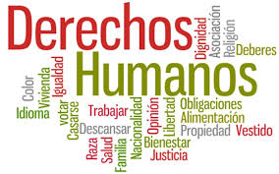
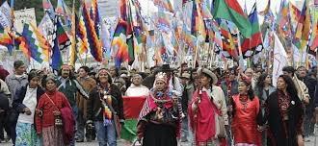
3.3 Inter-American Human Rights System
The Inter-American Human Rights System (IAHRS) protects the rights of Indigenous Peoples through the American Convention on Human Rights and various judgments of the Inter-American Court of Human Rights. The most relevant points include:
Right to Land and Resources: Recognition of the right of Indigenous Peoples to their ancestral lands and natural resources, and the obligation of States to guarantee their protection.
Prior Consultation: The need to carry out free, prior and informed consultations before making decisions that affect their territories and resources.
Cultural Identity: Protection of their cultural identity, traditions and customs.
Access to Justice: Guarantee of effective access to justice and redress for violations of their rights.

Slide 13


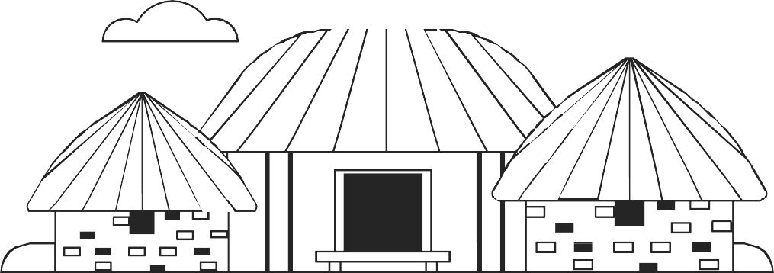



Collective rights of indigenous peoples
Right to self-determination: Includes the right of Indigenous Peoples to freely determine their political status and to pursue their rights to self-determination.Freely its economic, social and cultural development.
Rights over their lands and resources: Includes the right to ownership and possession of traditional lands and natural resources that traditionally occupied, used or acquired.
Right to free, prior and informed consultation: Recognizes the right of Indigenous Peoples to be consulted prior to the adoption of legislative or administrative measures that directly affect them, and to participate in decision-making that may affect their rights.

Slide 14


Collective rights of indigenous peoples
Right to maintain and develop their own institutional structure:
Right to cultural identity:
Right to redress and compensation for damages:
Includes the right to maintain and strengthen their traditional institutions, practices and customs, and to participate actively in public and private political situation of the country.
Includes the right to preserve, practice and revitalize their culture, languages, traditions and traditional ways of life.
Includes the right to redress and fair compensation for any harm they may suffer as a result of governmental, industrial or private activities or policies that affect their lands, resources or livelihoods.

Slide 15

What is it?
Convention 169 of the International Labor Organization is the main international instrument addressing the collective rights of Indigenous and tribal peoples.
CONVENTION 169 OF THE INTERNATIONAL LABOR ORGANIZATION

Slide 16

CONVENTION 169 OF THE INTERNATIONAL LABOR ORGANIZATION
What does it say?
What does it do?
Article 6 establishes the right of Indigenous Peoples to be consulted in advance and, if possible, to obtain their free and informed consent prior to the adoption of legislative or administrative measures that directly affect them.
Provides guidelines on how consultation should be carried out, ensuring that it is conducted in good faith, in a culturally appropriate manner and with sufficient time to allow Indigenous Peoples to make informed decisions.

Slide 17

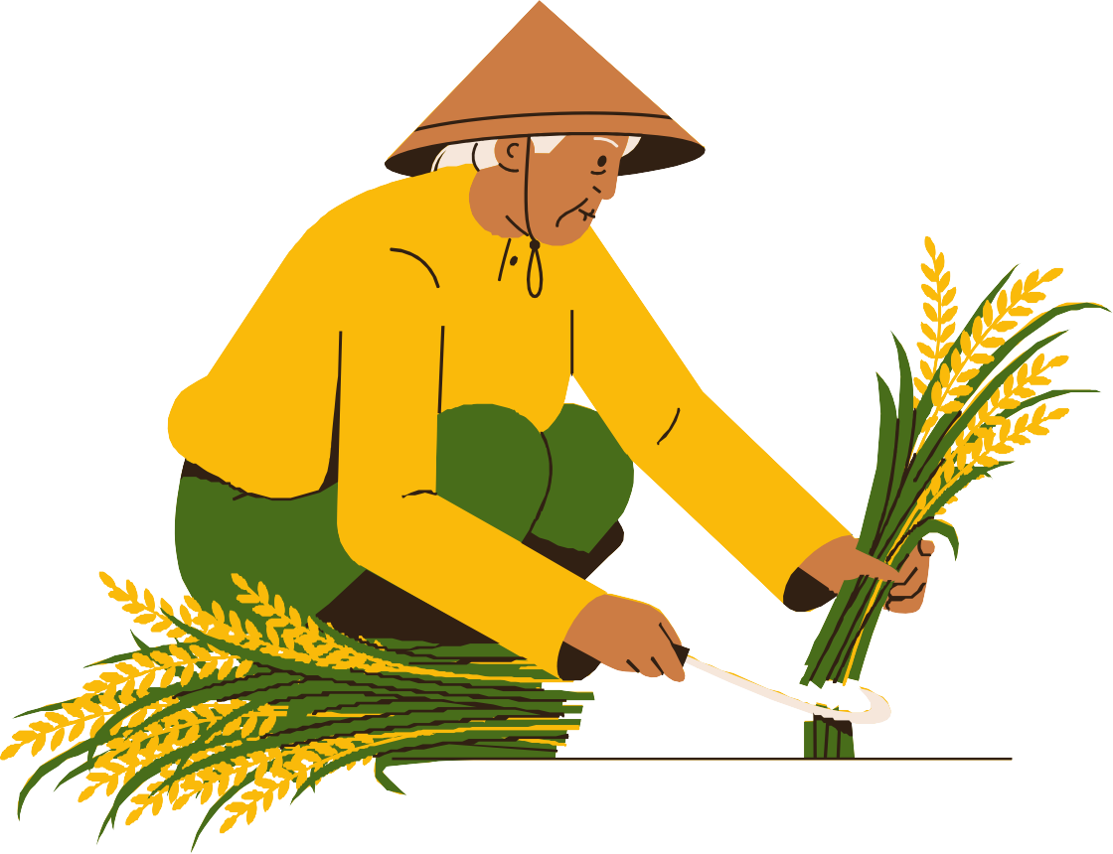
United Nations Declaration on the Rights of Indigenous Peoples.

Slide 18
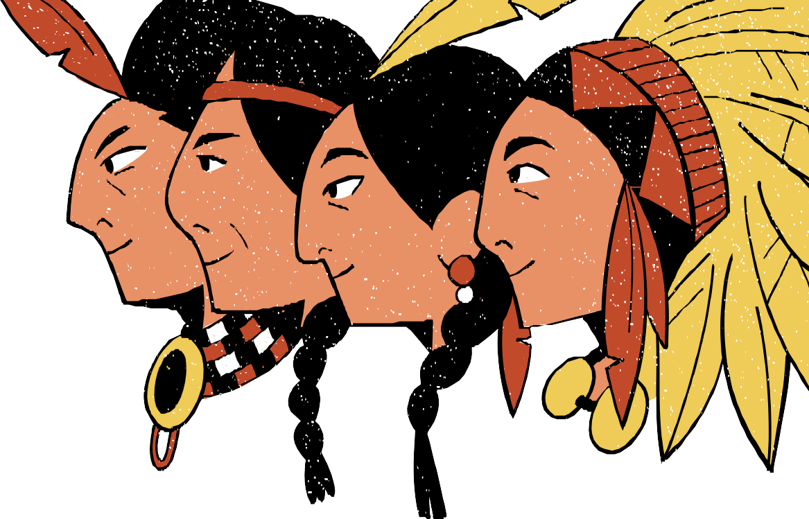

What does it do?
Adopted in 2007, the UNDRIP reaffirms the right of Indigenous peoples to free, prior and informed consultation in Article 19.
It establishes that states must consult and cooperate in good faith with Indigenous Peoples to obtain their free consent prior to approving any project affecting their lands or resources.
This statement underscores the importance of respecting and protecting the traditional knowledge, cultures and practices of Indigenous Peoples during the consultation process.

Slide 19
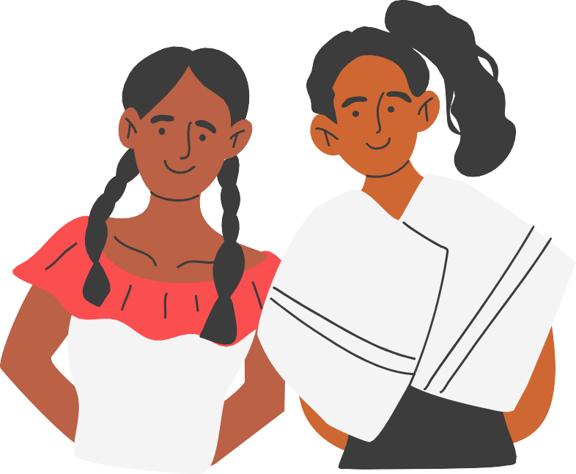

American Declaration on the Rights of Indigenous Peoples (ADRIPD)
2016
ART XVIII
Proposito
Recognizes the right to free and informed prior consultation in a manner appropriate to the circumstances and culture of the Indigenous Peoples affected.
Urges States to take effective measures to consult and cooperate with Indigenous Peoples in matters that directly affect them.
Approved by the OAS, the DADPI reaffirms Indigenous rights in the Americas.

Slide 20

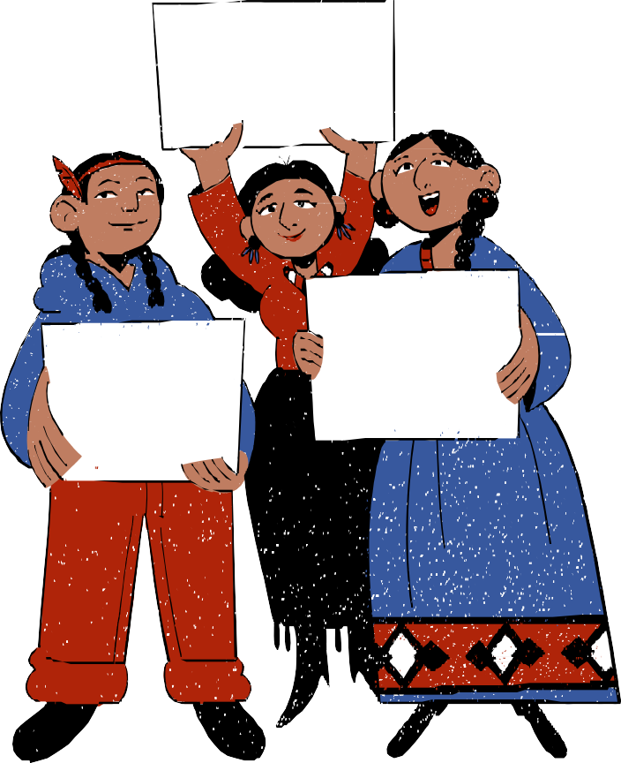


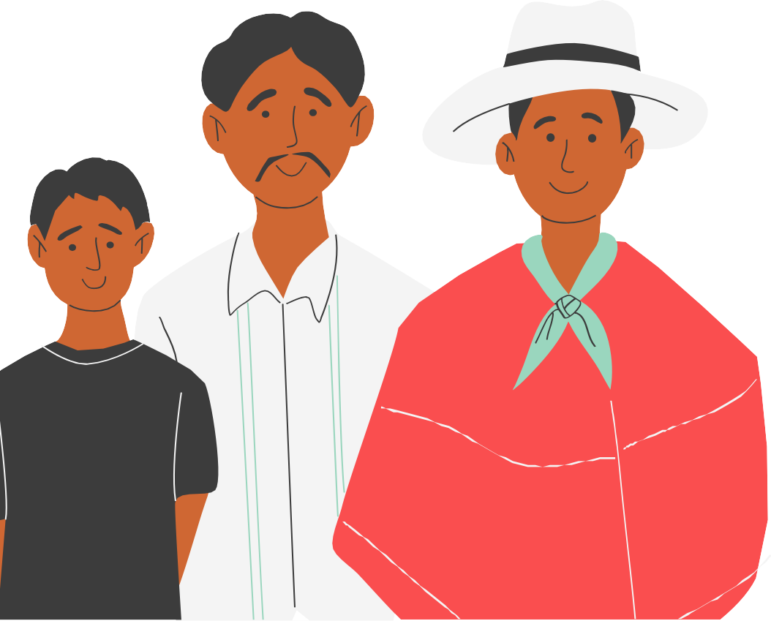

THANK YOU

Slide 21

  International Climate Change Agenda:

